Slide 1
Unit 2 Neural Networks
TFIP-AI Artificial Neural Networks and Deep Learning

Slide 2
Feed-forward Neural Network

Slide 3
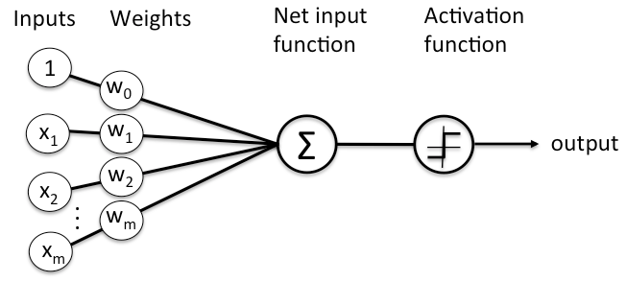
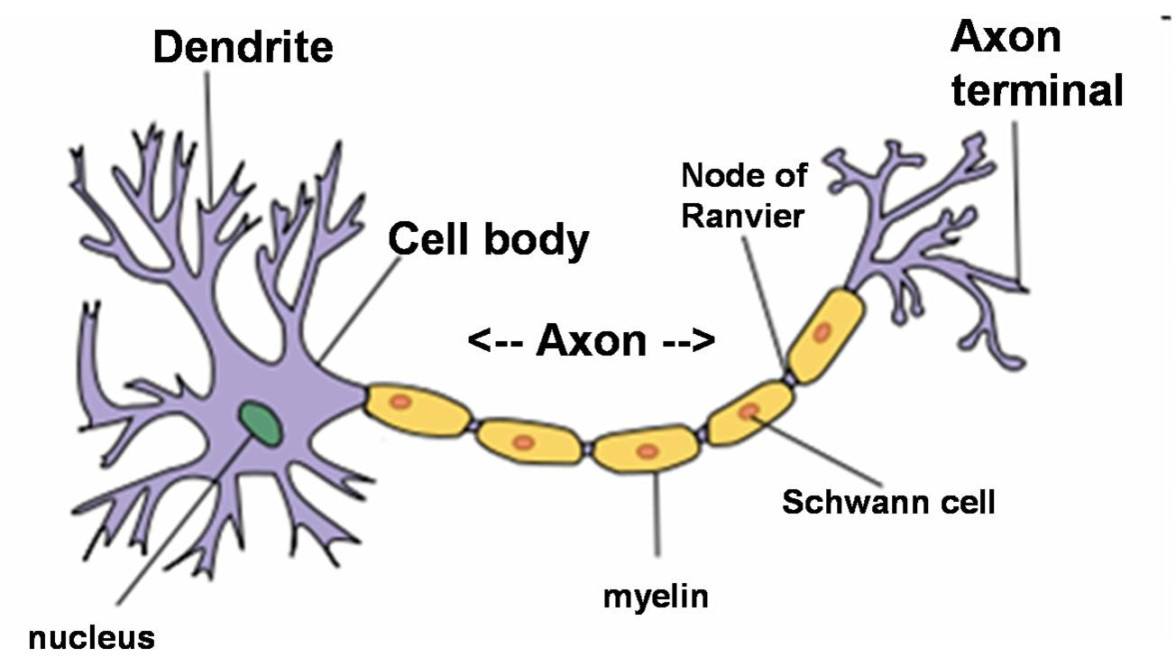
Neuron - perceptron

Slide 4
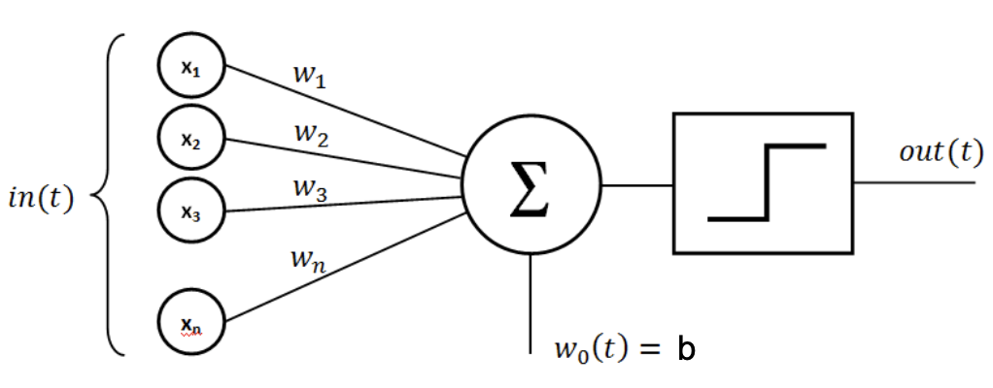
Perceptrons

Slide 5
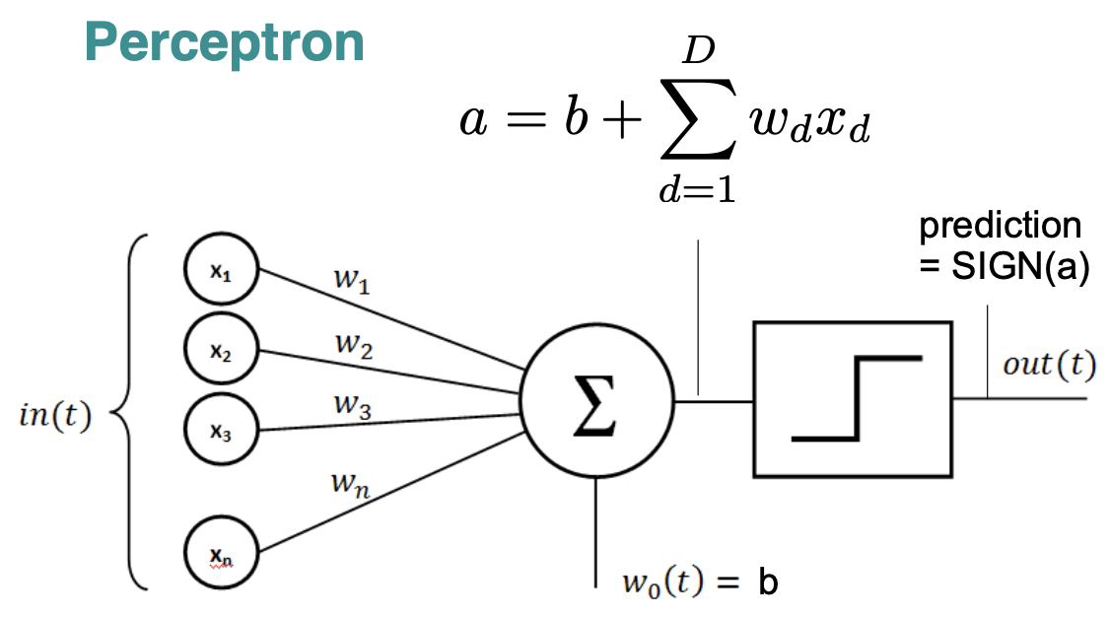
Perceptrons cont...

Slide 6
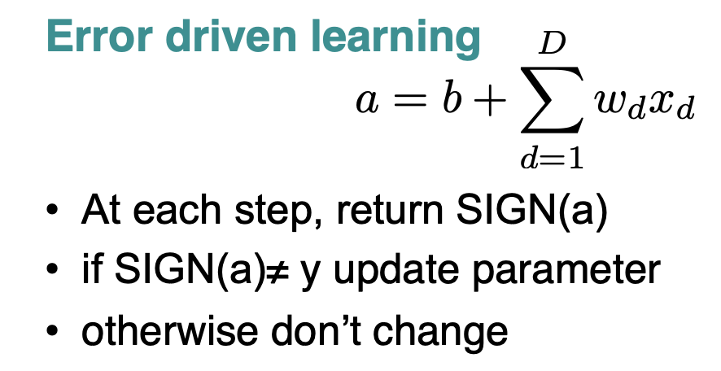
Perceptrons cont...

Slide 7
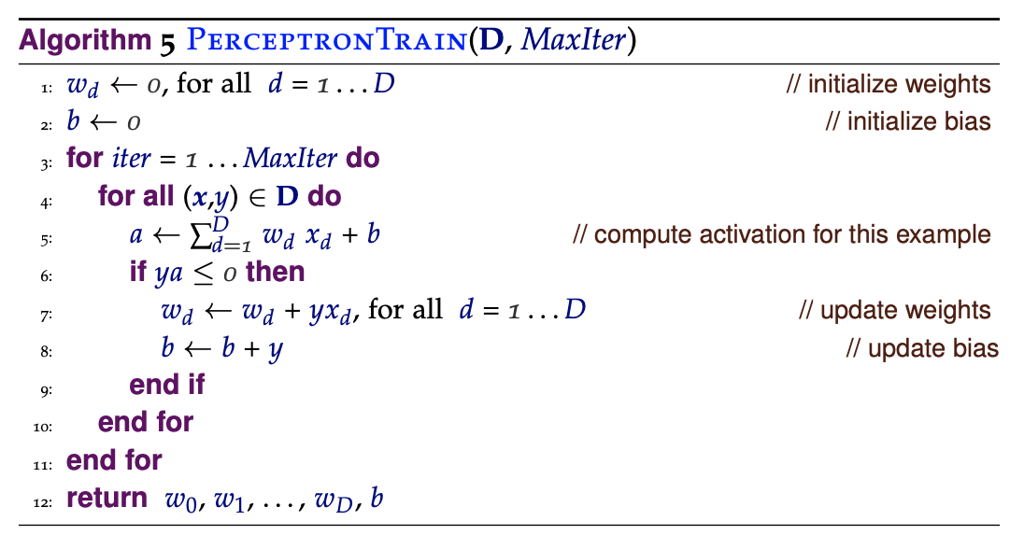
Perceptrons cont...

Slide 8
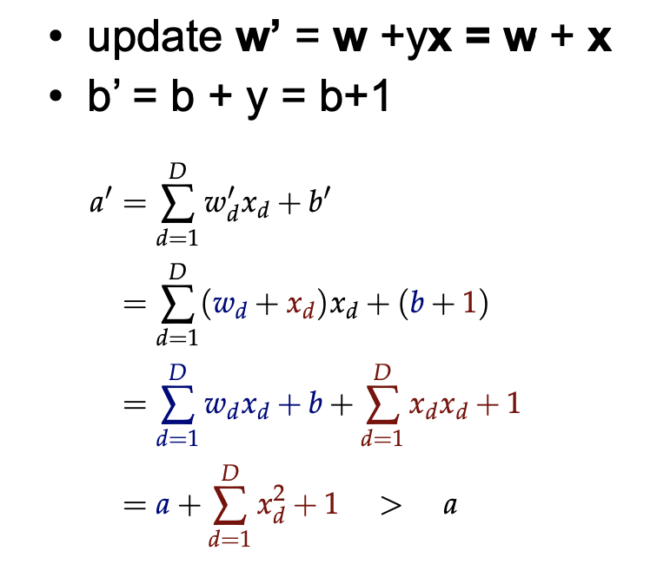
Perceptrons cont...
Does this move a in the right direction?

Slide 9
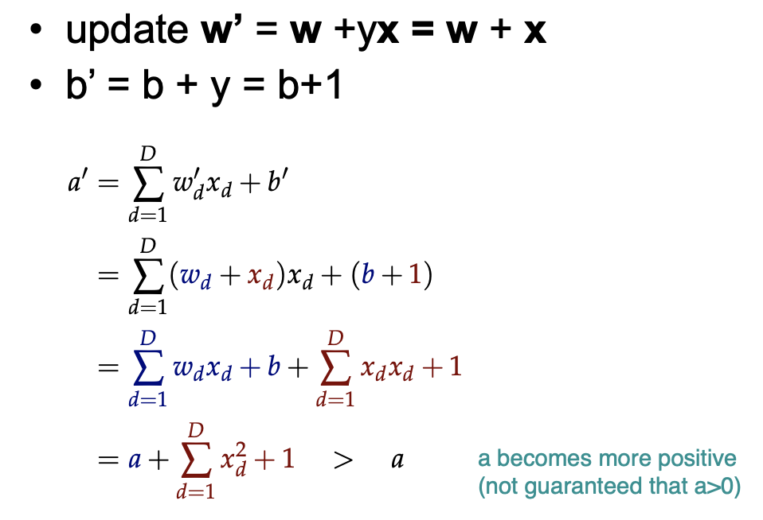
Perceptrons cont...
Does this move a in the right direction?

Slide 10
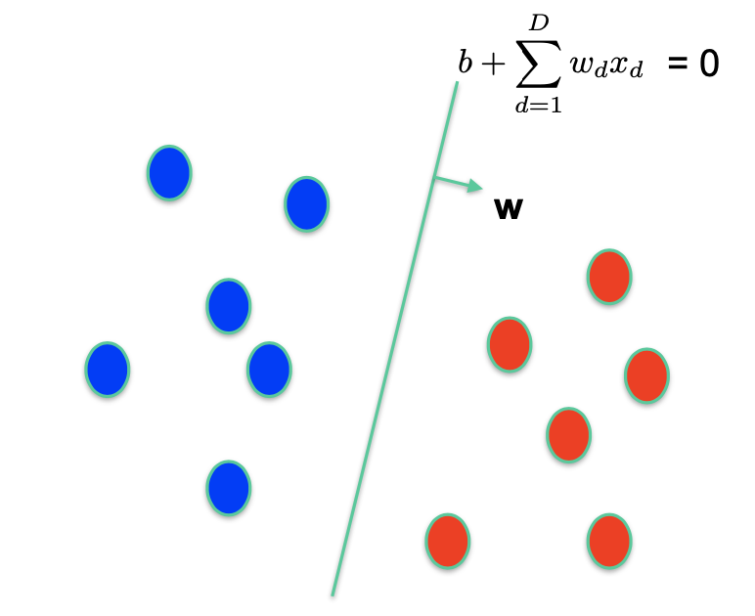
Perceptrons cont...
What is the decision boundary?

Slide 11
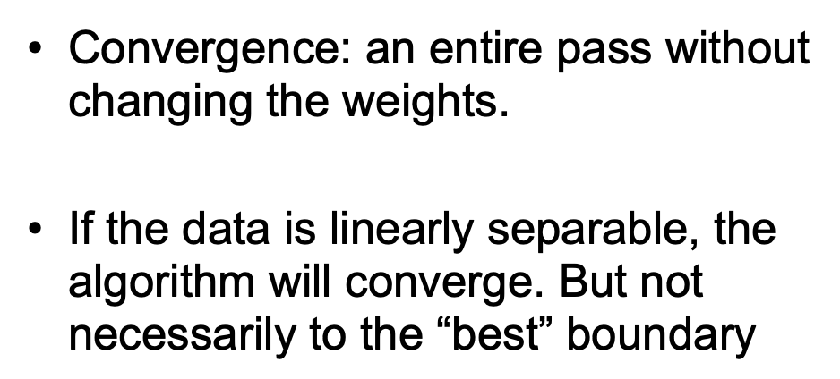
Perceptrons cont...
How good is this algorithm?

Slide 12
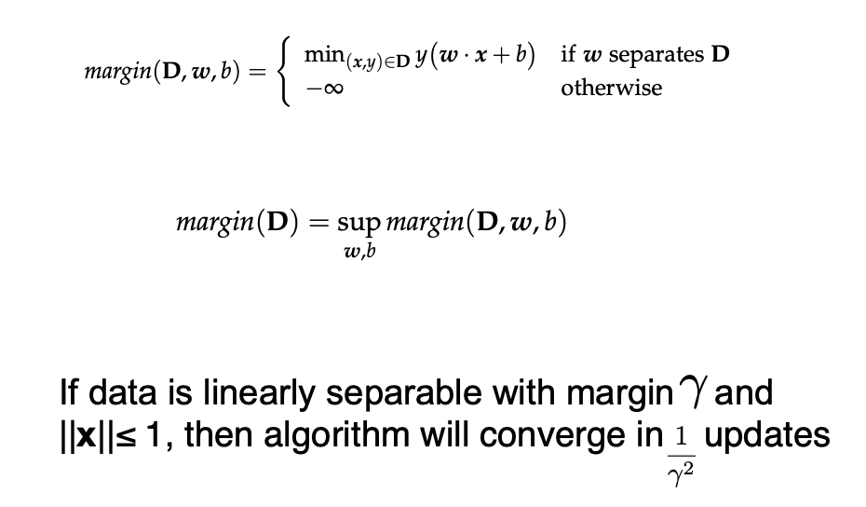
Perceptrons cont...
Notion of margin

Slide 13
Perceptrons cont...
The first generation of neural networks
They were popularised by Frank Rosenblatt in the early 1960’s.
They appeared to have a very powerful learning algorithm.
Lots of grand claims were made for what they could learn to do.
In 1969, Minsky and Papert published a book called “Perceptrons” that analysed what they could do and showed their limitations.
Many people thought these limitations applied to all neural network models.
The perceptron learning procedure is still widely used today for tasks with enormous feature vectors that contain many millions of features.

Slide 14
Perceptrons: training
Same as the learning method of logistic regression (with hard threshold or sigmoid function)
Pick training cases using any policy that ensures that every training case will keep getting picked.
If the output unit is correct, leave its weights alone.
If the output unit incorrectly outputs a zero, add the input vector to the weight vector.
If the output unit incorrectly outputs a 1, subtract the input vector from the weight vector.
This is guaranteed to find a set of weights that gets the right answer for all the training cases if any such set exists.

Slide 15
W= (0,0,0)
W= (4.5,0.2,0.1)
0.2×x₁+0.1×x₂+4.5=0
W= (4.5,0.2,-0.3)
0.2×x₁- 0.3×x₂+4.5=0
W= (4.5,0.2,-1.1)
0.2×x₁- 1.1×x₂+4.5=0
W= (4.5,0.2,-0.7)
0.2×x₁- 0.7×x₂+4.5=0

Slide 16
What perceptrons can’t do
0,1
1,1
weight plane
output =1
output =0
0,0
1,0
The positive and negative cases
cannot be separated by a plane

Slide 17
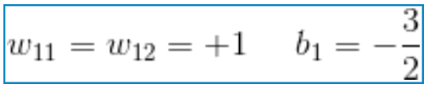
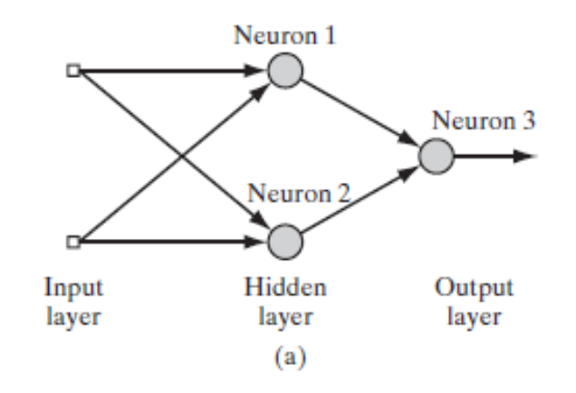
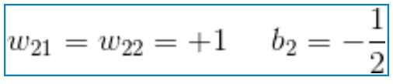
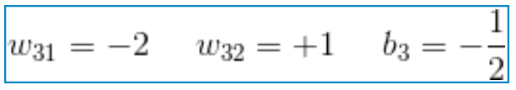
Hidden units
Without hidden units, perceptrons are very limited
More layers of linear units do not help. It’s still linear.
We need multiple layers of adaptive, non-linear hidden units.
Neuron1
Neuron2
Neuron3

Slide 18









N.N. Inference
$$−1.5$$
$$x_{1}$$
$$1$$
$$−2$$
$$1$$
$$1$$
$$−0.5$$
$$x_{2}$$
$$1$$
$$1$$
$$−0.5$$

Slide 19
N.N. Inference

Slide 20
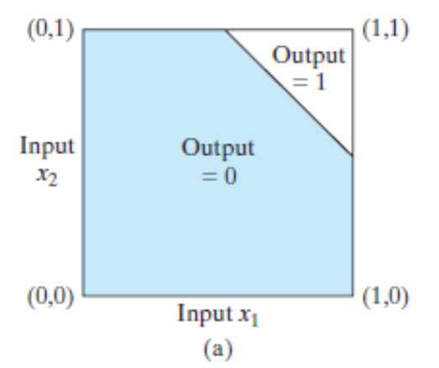
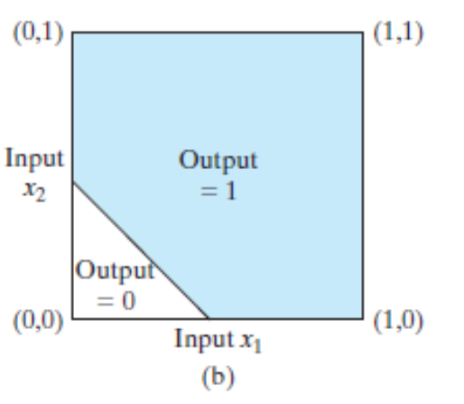
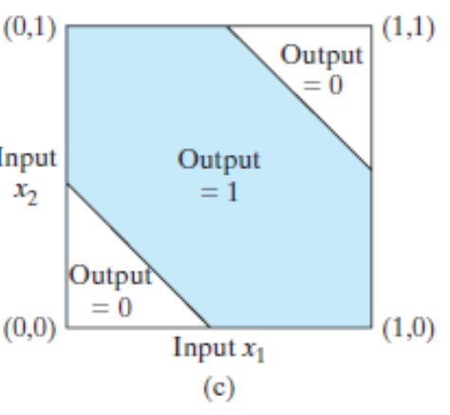
XOR Problem
Neuron3
Neuron1
Neuron2

Slide 21
Loss function
how can we train such nets?
We need an efficient way of adapting all the weights, not just the last layer. This is hard.
Learning the weights going into hidden units is equivalent to learning features.
This is difficult because nobody is telling us directly what the hidden units should do.

Slide 22
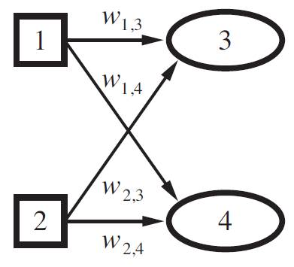
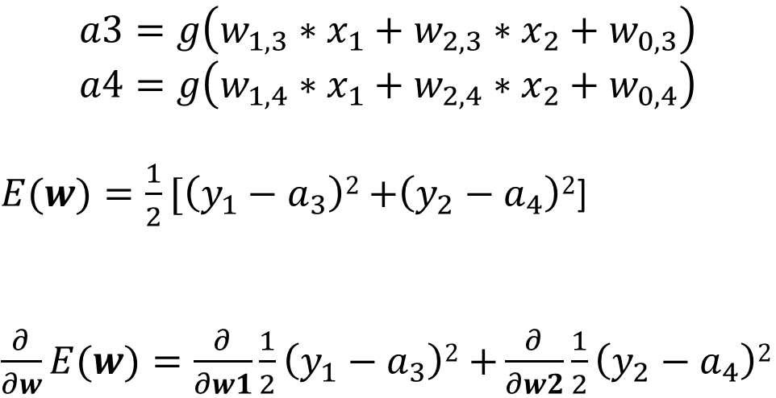



Learning - single layered
For a single sample (x1,x2)
$$x_{1}$$
$$a_{3}$$
$$a3=g\left(w_{1,3}∗x_{1}+w_{2,3}∗x_{2}+w_{0,3}\right)$$
$$a4=g\left(w_{1,4}∗x_{1}+w_{2,4}∗x_{2}+w_{0,4}\right)$$
$E(w)=\frac{1}{2}[\left(y_{1}−a_{3}\right)2$ $+\left(y_{2}−a_{4}\right)2$]
$\frac{∂}{∂w}E(w)=\frac{∂}{∂w1}\frac{1}{2}\left(y_{1}−a_{3}\right)2$ $+\frac{∂}{∂w2}\frac{1}{2}\left(y_{2}−a_{4}\right)2$
$$x_{2}$$
$$a_{4}$$

Slide 23
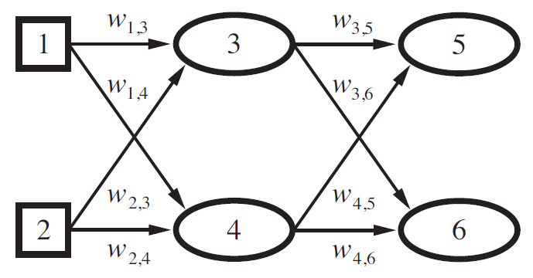
Difficulty in learning with multilayer
Error at the output layer is clear,
Error at the hidden layers seems mysterious
- the training data do not say what value the hidden nodes should have.

Slide 24


Error Back-propagate
Now Error at the hidden layers can be estimated
$$e_{5}$$
Error of Node3 is back propagated from e5 and e6
$$e_{6}$$

Slide 25

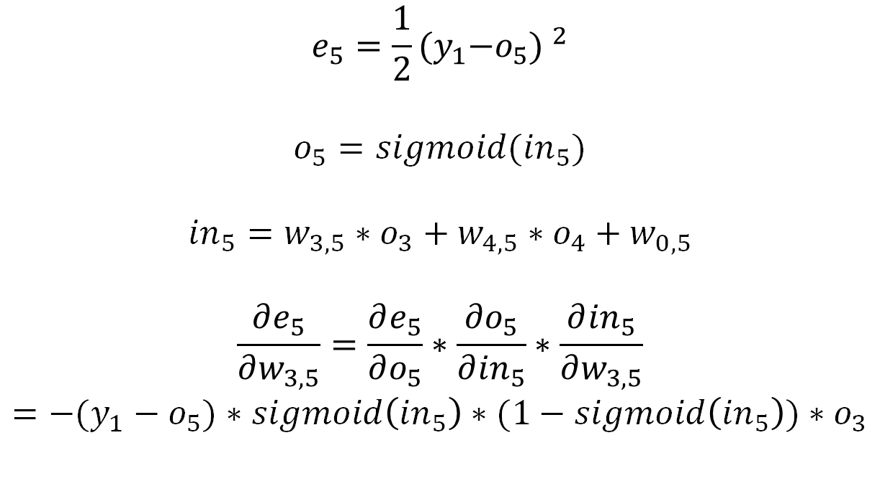
Output layer weight learning – chain rule
$$e_{5}=\frac{1}{2}{{(y}_{1}−o_{5}) }^{2}$$
$$o_{5}=sigmoid({in}_{5})$$
${in}_{5}=w_{3,5}∗o_{3}+w_{4,5}∗o_{4}$ $+ w_{0,5}$
$$\frac{∂e_{5}}{∂w_{3,5}}=\frac{∂e_{5}}{∂o_{5}}∗\frac{∂o_{5}}{∂{in}_{5}}∗\frac{∂{in}_{5}}{∂w_{3,5}}$$
$$=−(y_{1}−o_{5})∗sigmoid\left({in}_{5}\right)∗(1−sigmoid\left({in}_{5}\right))∗o_{3}$$
Now Error at the hidden layers can be estimated
$$e_{5}$$
$$e_{6}$$
$$sigmoid{\left(x\right)}^{′}=sigmoid\left(x\right)∗(1−sigmoid(x))$$

Slide 26
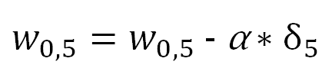
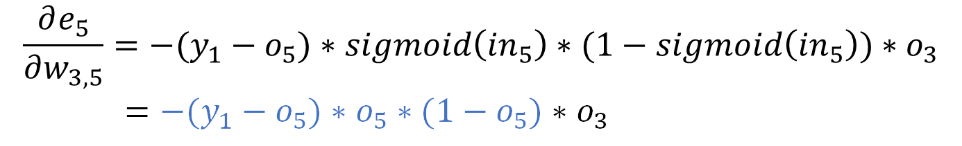
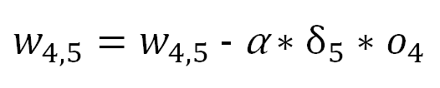
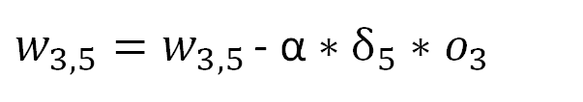


Output layer weight learning – delta rule
Gradient e5
$$\frac{∂e_{5}}{∂w_{3,5}}=−(y_{1}−o_{5})∗sigmoid\left({in}_{5}\right)∗(1−sigmoid\left({in}_{5}\right))∗o_{3}$$
$=−(y_{1}−o_{5})∗o_{5}∗(1−o_{5})∗o_{3}$
$$δ_{5}$$
Gradient Descent
$$\frac{∂e_{5}}{∂w_{4,5}}=δ_{5}∗o_{4}$$
$w_{3,5}=w_{3,5 }$- α $∗δ_{5}∗o_{3}$
$w_{4,5}=w_{4,5}$ - α $∗δ_{5}∗o_{4}$
$$\frac{∂e_{5}}{∂w_{0,5}}=δ_{5}$$
$w_{0,5}=w_{0,5}$ - α $∗δ_{5}$

Slide 27
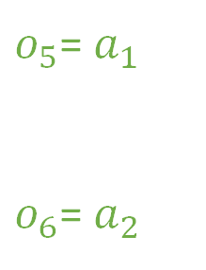
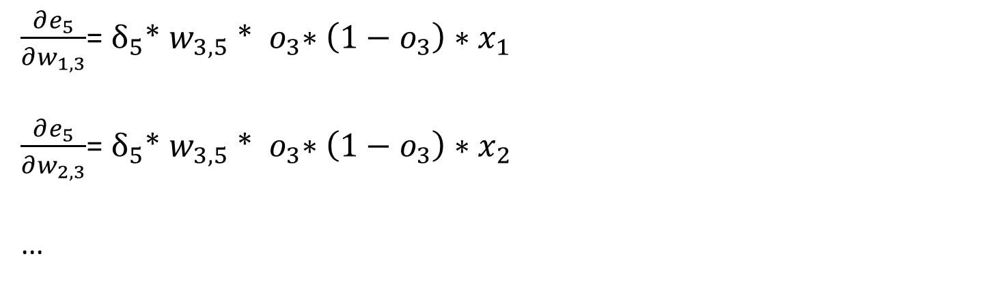
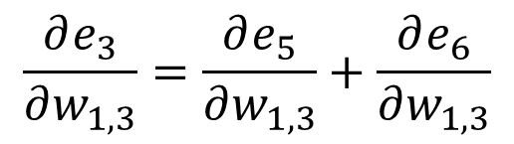

Hidden layer weight learning
$$e_{5}$$
$o_{5}$= $a_{1}$
$o_{6}$= $a_{2}$
$$e_{3}=e_{5}+e_{6}$$
$$\frac{∂e_{3}}{∂w_{1,3}}=\frac{∂e_{5}}{∂w_{1,3}}+\frac{∂e_{6}}{∂w_{1,3}}$$
$$e_{6}$$
$\frac{∂e_{5}}{∂w_{1,3}}$= $δ_{5}$* $w_{3,5}$ *${ o}_{3}∗\left(1−o_{3}\right)∗x_{1}$
$\frac{∂e_{5}}{∂w_{2,3}}$= $δ_{5}$* $w_{3,5}$ *${ o}_{3}∗\left(1−o_{3}\right)∗x_{2}$
…

Slide 28
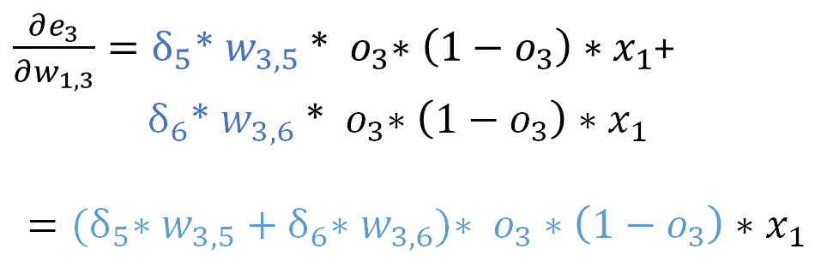
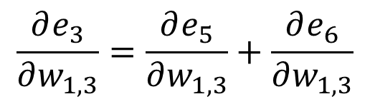


Hidden layer weight learning
$$e_{5}$$
$$e_{3}=e_{5}+e_{6}$$
$$e_{6}$$
$$\frac{∂e_{3}}{∂w_{1,3}}=\frac{∂e_{5}}{∂w_{1,3}}+\frac{∂e_{6}}{∂w_{1,3}}$$
$\frac{∂e_{3}}{∂w_{1,3}}=δ_{5}$* $w_{3,5}$ *${ o}_{3}∗\left(1−o_{3}\right)∗x_{1}$+
$δ_{6}$* $w_{3,6}$ *${ o}_{3}∗\left(1−o_{3}\right)∗x_{1}$
$$={(δ}_{5}\text{∗ }w_{3,5}+δ_{6}\text{∗ }w_{3,6})\text{∗} { o}_{3}∗\left(1−o_{3}\right)∗x_{1}$$
$\frac{∂e_{5}}{∂w_{1,3}}$= $δ_{5}$* $w_{3,5}$ *${ o}_{3}∗\left(1−o_{3}\right)∗x_{1}$
$\frac{∂e_{5}}{∂w_{2,3}}$= $δ_{5}$* $w_{3,5}$ *${ o}_{3}∗\left(1−o_{3}\right)∗x_{2}$
…
$$δ_{3}$$
$$sigmoid{\left(x\right)}^{′}$$

Slide 29
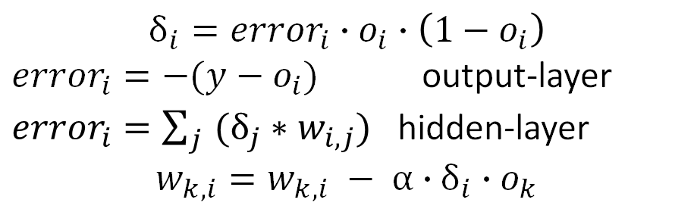
BP algorithm (stochastic + sigmoid)
Step0 define # of layers, # of nodes
Step1 initialize parameters: weights and bias
Step2 feed forward
Calculate output for each non-input layer node
Step3 back propagate
Compute sensitivity for each non-input layer node i
Update parameters
Step4 Convergence
Compute cost function
Repeat step2 until convergence
sensitivity
$$δ_{i}={error}_{i}∙o_{i}∙\left(1−o_{i}\right)$$
${error}_{i}=−(y−$ $o_{i})$ output-layer
${error}_{i}=\sum_{j}{(δ_{j}∗}$ $w_{i,j})$ hidden-layer
$$w_{k,i}=w_{k,i} − α∙δ_{i}∙o_{k}$$

Slide 30
Back-propagate - Example

Slide 31


B.P. Example – the Network
${in}_{3}=$ $x_{1}∙w_{1,3}+x_{2}∙w_{2,3}+w_{0,3}$
$o_{3}=$ $sigmoid({in}_{3})$

Slide 32
B.P. Example – Feed Forward
$o_{3}=$ $sigmoid(x_{1}∙w_{1,3}+x_{2}∙w_{2,3}+w_{0,3})$
$o_{4}=$ $sigmoid(x_{1}∙w_{1,4}+x_{2}∙w_{2,4}+w_{0,4})$
$o_{5}=$ $sigmoid(o_{3}∙w_{3,5}+o_{4}∙w_{4,5}+w_{0,5})$
$o_{6}=$ $sigmoid(o_{3}∙w_{3,6}+o_{4}∙w_{4,6}+w_{0,6})$
$δ_{5}=$ $−(y_{1}−o_{5})∙o_{5}∙(1−o_{5})$
$δ_{6}=$ $−(y_{2}−o_{6})∙o_{6}∙(1−o_{6})$

Slide 33












B.P. Example – Learning (stochastic)
$$δ_{3}=o_{3}∙\left(1−o_{3}\right)∙(δ_{5}∙ w_{3,5}+δ_{6}∙ w_{3,6})$$
$$w_{3,5}=w_{3,5}−α∙δ_{5}∙o_{3}$$
$$w_{4,5}=w_{4,5}−α∙δ_{5}∙o_{4}$$
$$δ_{4}=o_{4}∙\left(1−o_{4}\right)∙(δ_{5}∙ w_{4,5}+δ_{6}∙ w_{4,6})$$
$w_{0,5}=w_{0,5}−α∙δ_{5}$ $∙1$
$$w_{3,6}=w_{3,6}−α∙δ_{6}∙o_{3}$$
$$w_{1,3}=w_{1,3}−α∙δ_{3}∙x_{1}$$
$$w_{1,4}=w_{1,4}−α∙δ_{4}∙x_{1}$$
$$w_{4,6}=w_{4,6}−α∙δ_{6}∙o_{4}$$
$$w_{2,3}=w_{2,3}−α∙δ_{3}∙x_{2}$$
$$w_{2,4}=w_{2,4}−α∙δ_{4}∙x_{2}$$
$w_{0,6}=w_{0,6}−α∙δ_{6}$ $∙1$
$w_{0,3}=w_{0,3}−α∙δ_{3}$ $∙1$
$w_{0,4}=w_{0,4}−α∙δ_{4}$ $∙1$

Slide 34
XOR with 2 nodes hidden layer
X1 | X2 | Y
0 | 0 | 0
0 | 1 | 1
1 | 0 | 1
1 | 1 | 0

Slide 35
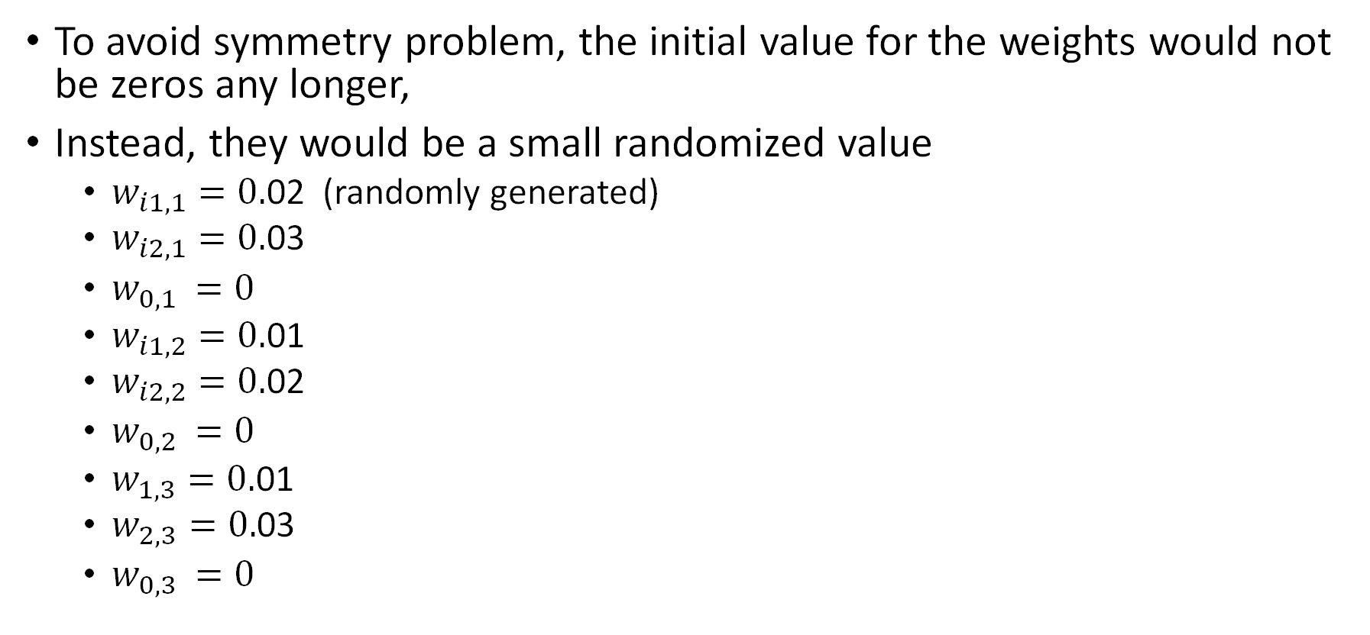
Parameter initialization
To avoid symmetry problem, the initial value for the weights would not be zeros any longer,
Instead, they would be a small randomized value
$w_{i1,1}=0.$02 (randomly generated)
$w_{i2,1}=0.$03
$w_{0,1 }=0$
$w_{i1,2}=0.$01
$w_{i2,2}=0.$02
$w_{0,2 }=0$
$w_{1,3}=0.$01
$w_{2,3}=0.$03
$w_{0,3 }=0$

Slide 36

Feed forward – input(0,0)
$o_{1}=sigmoid(0) =0.5$
$o_{2}=sigmoid(0) =0.5$
$o_{3}=sigmoid\left(0.5∙0.01+0.5∙0.03+0\right)=0.505$

Slide 37
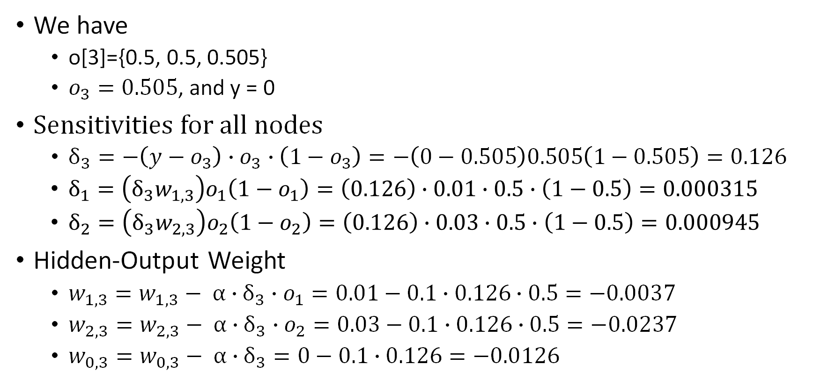
Back propagate – input(0,0)
We have
o[3]={0.5, 0.5, 0.505}
$o_{3}=0.505$, and y = 0
Sensitivities for all nodes
$δ_{3}=−\left(y−o_{3}\right)∙o_{3}∙\left(1−o_{3}\right)=−\left(0−0.505\right)0.505\left(1−0.505\right)=0.126$
$δ_{1}={\left(δ_{3}w_{1,3}\right)o}_{1}\left(1−o_{1}\right)=\left(0.126\right)∙0.01∙0.5∙\left(1−0.5\right)=0.000315$
$δ_{2}={\left(δ_{3}w_{2,3}\right)o}_{2}\left(1−o_{2}\right)=\left(0.126\right)∙0.03∙0.5∙\left(1−0.5\right)=0.000945$
Hidden-Output Weight
$w_{1,3}=w_{1,3}− α∙δ_{3}∙o_{1}=0.01−0.1∙0.126∙0.5=−0.0037$
$w_{2,3}=w_{2,3}− α∙δ_{3}∙o_{2}=0.03−0.1∙0.126∙0.5=−0.0237$
$w_{0,3}=w_{0,3}− α∙δ_{3}=0−0.1∙0.126=−0.0126$

Slide 38
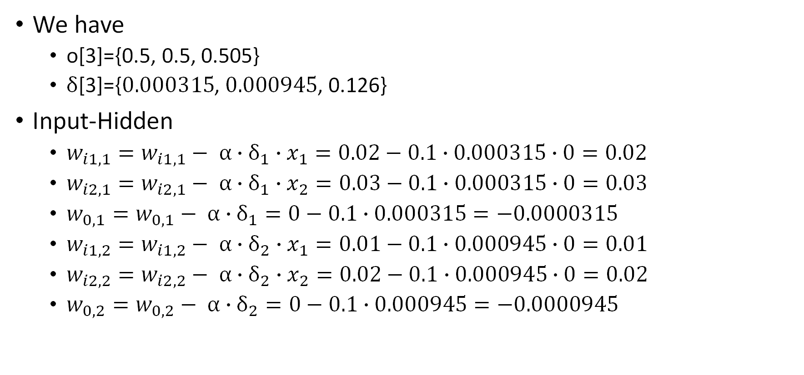
Back propagate – input(0,0)
We have
o[3]={0.5, 0.5, 0.505}
$δ$[3]={$0.000315$, $0.000945$, 0.126}
Input-Hidden
$w_{i1,1}=w_{i1,1}− α∙δ_{1}∙x_{1}=0.02−0.1∙0.000315∙0=0.02$
$w_{i2,1}=w_{i2,1}− α∙δ_{1}∙x_{2}=0.03−0.1∙0.000315∙0=0.03$
$w_{0,1}=w_{0,1}− α∙δ_{1}=0−0.1∙0.000315=−0.0000315$
$w_{i1,2}=w_{i1,2}− α∙δ_{2}∙x_{1}=0.01−0.1∙0.000945∙0=0.01$
$w_{i2,2}=w_{i2,2}− α∙δ_{2}∙x_{2}=0.02−0.1∙0.000945∙0=0.02$
$w_{0,2}=w_{0,2}− α∙δ_{2}=0−0.1∙0.000945=−0.0000945$

Slide 39
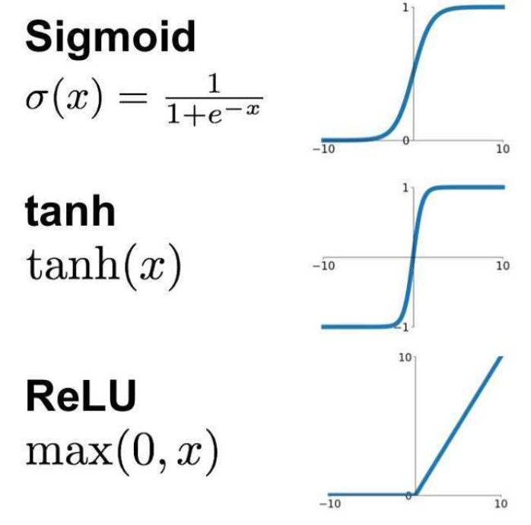
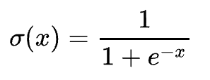




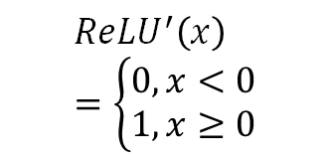
Activation Functions
sigmoid
Gradient vanishing
Output is not zero-centered – slow down the learning
Power operation – time cost
tanh (Hyperbolic Tangent)
Gradient vanishing
Output is not zero-centered
Power operation
Relu
Gradient vanishing
Output is not zero-centered
Power operation
Dead Relu Problem
$$\text{σ}(x)∙\left(1−\text{σ}(x)\right)$$
$$1−\text{tanh}\left(x\right)2$$
$${ReLU}^{′}\left(x\right)=\left\{\begin{matrix}0, x<0 \\ 1, x≥0\end{matrix}\right.$$

Slide 40
XOR with 2 nodes hidden layer - vectorization
Hidden layer
tanh
Output layer
sigmoid
X0 | X1 | X2 | Y
1 | 0 | 0 | 0
1 | 0 | 1 | 1
1 | 1 | 0 | 1
1 | 1 | 1 | 0
X is a 4 × 3 matrix
Y is a 4 × 1 vector

Slide 41


Parameter initialization
Hidden layer
Weight_hidden =$\left[\begin{matrix}0.02 & 0.01 \\ 0.03 & 0.02\end{matrix}\right]$
Bias_hidden=[$\begin{matrix}0 & 0\end{matrix}]$
Output layer
Weight_output =$\left[\begin{aligned}0.01 \\ 0.03\end{aligned}\right]$
Bias_output=$[0]$
$w_{i1,1}=0.$02
$w_{i2,1}=0.$03
$$w_{0,1 }=0$$
$w_{i1,2}=0.$01
$w_{i2,2}=0.$02
$$w_{0,2 }=0$$
$w_{1,3}=0.$01
$w_{2,3}=0.$03
$$w_{0,3 }=0$$

Slide 42
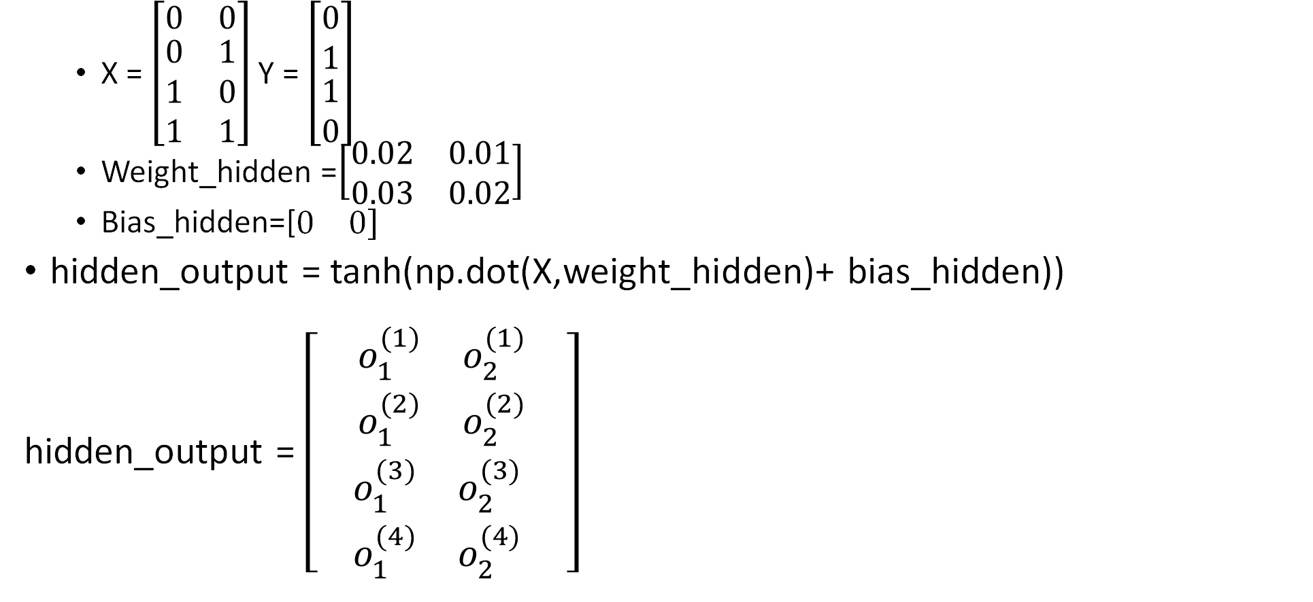
Feed forward – Hidden layer output
X = $\left[\begin{matrix}0 & 0 \\ \begin{aligned}0 \\ 1 \\ 1\end{aligned} & \begin{aligned}1 \\ 0 \\ 1\end{aligned}\end{matrix}\right]$Y = $\left[\begin{matrix}0 \\ 1 \\ \begin{aligned}1 \\ 0\end{aligned}\end{matrix}\right]$
Weight_hidden =$\left[\begin{matrix}0.02 & 0.01 \\ 0.03 & 0.02\end{matrix}\right]$
Bias_hidden=[$\begin{matrix}0 & 0\end{matrix}]$
hidden_output = tanh(np.dot(X,weight_hidden)+ bias_hidden))
hidden_output = $\left[\begin{aligned}\begin{matrix}o_{1}^{(1)} & o_{2}^{(1)} \\ o_{1}^{(2)} & o_{2}^{(2)}\end{matrix} \\ \begin{matrix}o_{1}^{(3)} & o_{2}^{(3)} \\ o_{1}^{(4)} & o_{2}^{(4)}\end{matrix} \end{aligned}\right]$

Slide 43
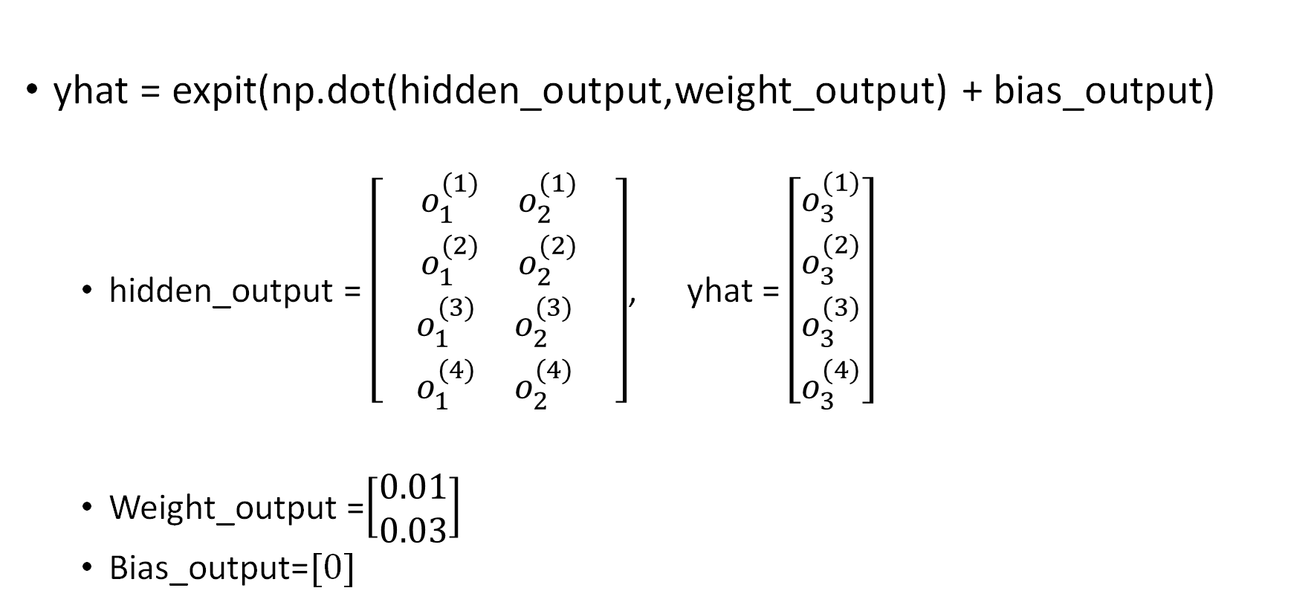
Feed forward – output layer output
yhat = expit(np.dot(hidden_output,weight_output) + bias_output)
hidden_output = $\left[\begin{aligned}\begin{matrix}o_{1}^{(1)} & o_{2}^{(1)} \\ o_{1}^{(2)} & o_{2}^{(2)}\end{matrix} \\ \begin{matrix}o_{1}^{(3)} & o_{2}^{(3)} \\ o_{1}^{(4)} & o_{2}^{(4)}\end{matrix} \end{aligned}\right]$, yhat = $\left[\begin{matrix}o_{3}^{(1)} \\ \begin{aligned}o_{3}^{(2)} \\ o_{3}^{(3)} \\ o_{3}^{(4)}\end{aligned}\end{matrix}\right]$
Weight_output =$\left[\begin{aligned}0.01 \\ 0.03\end{aligned}\right]$
Bias_output=$[0]$

Slide 44
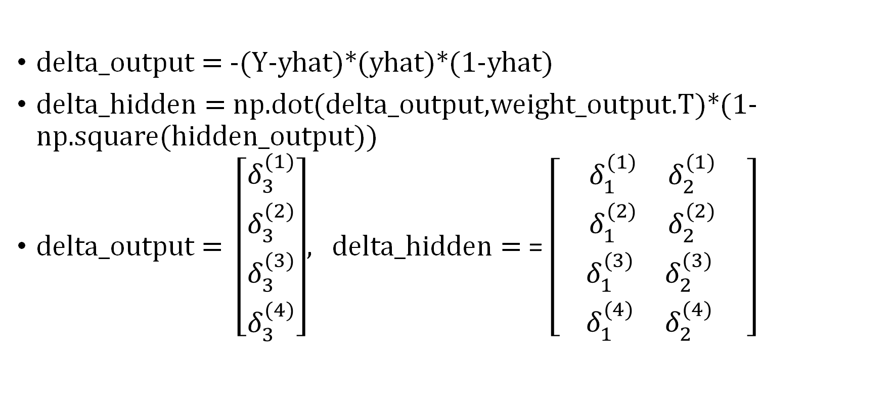
Sensitivity computing
delta_output = -(Y-yhat)*(yhat)*(1-yhat)
delta_hidden = np.dot(delta_output,weight_output.T)*(1-np.square(hidden_output))
delta_output = $\left[\begin{matrix}δ_{3}^{(1)} \\ \begin{aligned}δ_{3}^{(2)} \\ δ_{3}^{(3)} \\ δ_{3}^{(4)}\end{aligned}\end{matrix}\right]$, delta_hidden = = $\left[\begin{aligned}\begin{matrix}δ_{1}^{(1)} & δ_{2}^{(1)} \\ δ_{1}^{(2)} & δ_{2}^{(2)}\end{matrix} \\ \begin{matrix}δ_{1}^{(3)} & δ_{2}^{(3)} \\ δ_{1}^{(4)} & δ_{2}^{(4)}\end{matrix} \end{aligned}\right]$

Slide 45
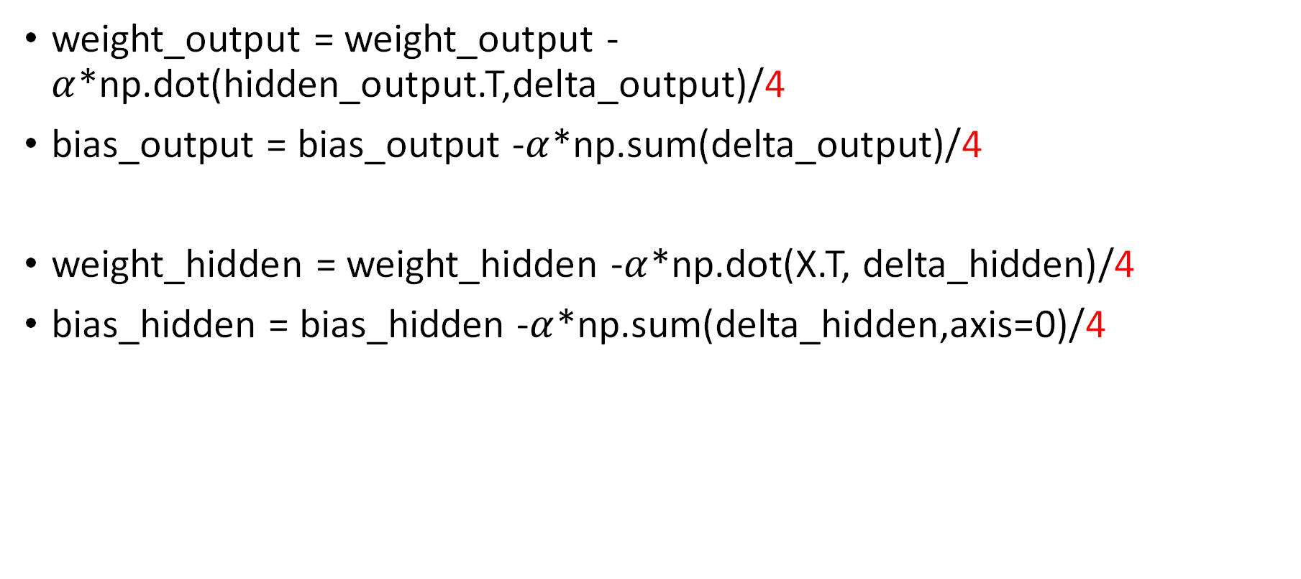
Parameters Update
weight_output = weight_output - $α$*np.dot(hidden_output.T,delta_output)/4
bias_output = bias_output -$α$*np.sum(delta_output)/4
weight_hidden = weight_hidden -$α$*np.dot(X.T, delta_hidden)/4
bias_hidden = bias_hidden -$α$*np.sum(delta_hidden,axis=0)/4

Slide 46
Weight Initialization

Slide 47
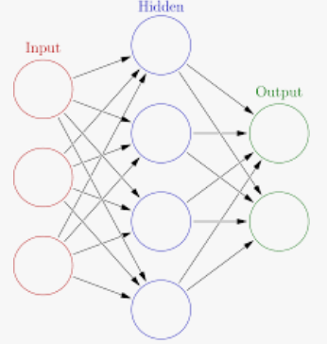
All Zero Initialization(pitfall)
We assume: with proper data normalization
Half of the weights will be positive
Half of them will be negative
0 would be the best guess
It is a mistake
Same output → same gradient → same parameter updates
Logistic Regression
All 0 initialization is ok

Slide 48
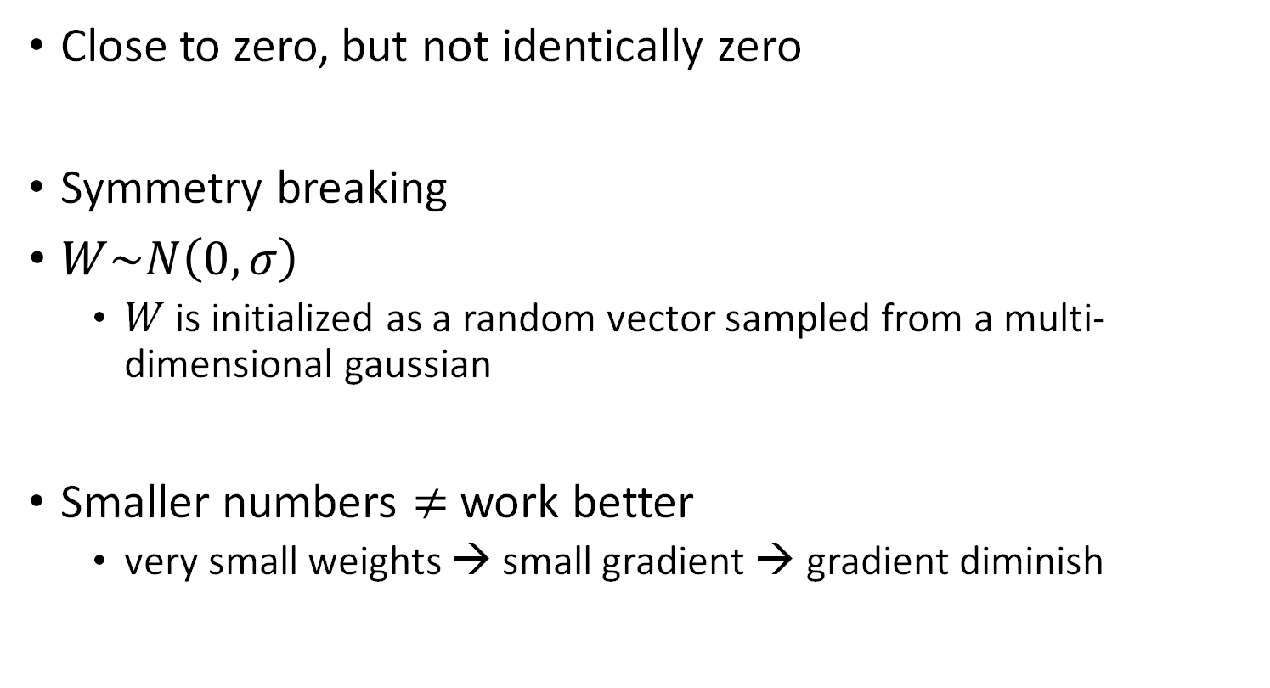
Small random numbers
Close to zero, but not identically zero
Symmetry breaking
$W\sim N\left(0,σ\right)$
$W$ is initialized as a random vector sampled from a multi-dimensional gaussian
Smaller numbers $≠$ work better
very small weights → small gradient → gradient diminish

Slide 49

Uniform distribution initialization
$$W\sim U[−\frac{1}{\sqrt{n_{in}}},\frac{1}{\sqrt{n_{in}}}]$$
where $U[−a,a]$ is the uniform distribution in the interval (−a,a), and $n_{in}$ is the size of the previous layer

Slide 50
Xavier initialization
Problems in weights initialization
If the weights in a network start too small, then the signal shrinks as it passes through each layer until it’s too tiny to be useful. (Gradient Vanishing)
If the weights in a network start too large, then the signal grows as it passes through each layer until it’s too massive to be useful. (Gradient Exploding)
Gaussian distribution with zero mean and a suitable variance

Slide 51
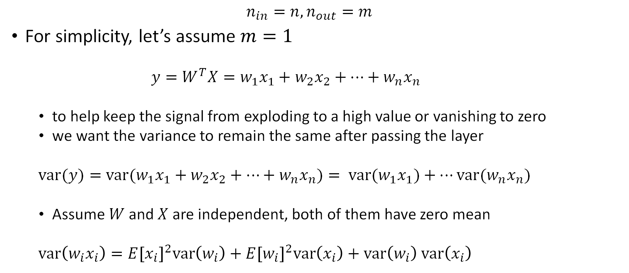
Xavier initialization
$$n_{in}=n, n_{out}=m$$
For simplicity, let’s assume $m=1$
$y=W^{T}X=w_{1}x_{1}+$ $w_{2}x_{2}+…+w_{n}x_{n}$
to help keep the signal from exploding to a high value or vanishing to zero
we want the variance to remain the same after passing the layer
$var(y)=var(w_{1}x_{1}+$ $w_{2}x_{2}+…+w_{n}x_{n})= var(w_{1}x_{1})+…var(w_{n}x_{n})$
Assume $W$and $X$are independent, both of them have zero mean
$var\left(w_{i}x_{i}\right)={E[x_{i}]}^{2}var\left(w_{i}\right)+$ ${E[w_{i}]}^{2}var\left(x_{i}\right)+$ $var\left(w_{i}\right)$ $var\left(x_{i}\right)$

Slide 52
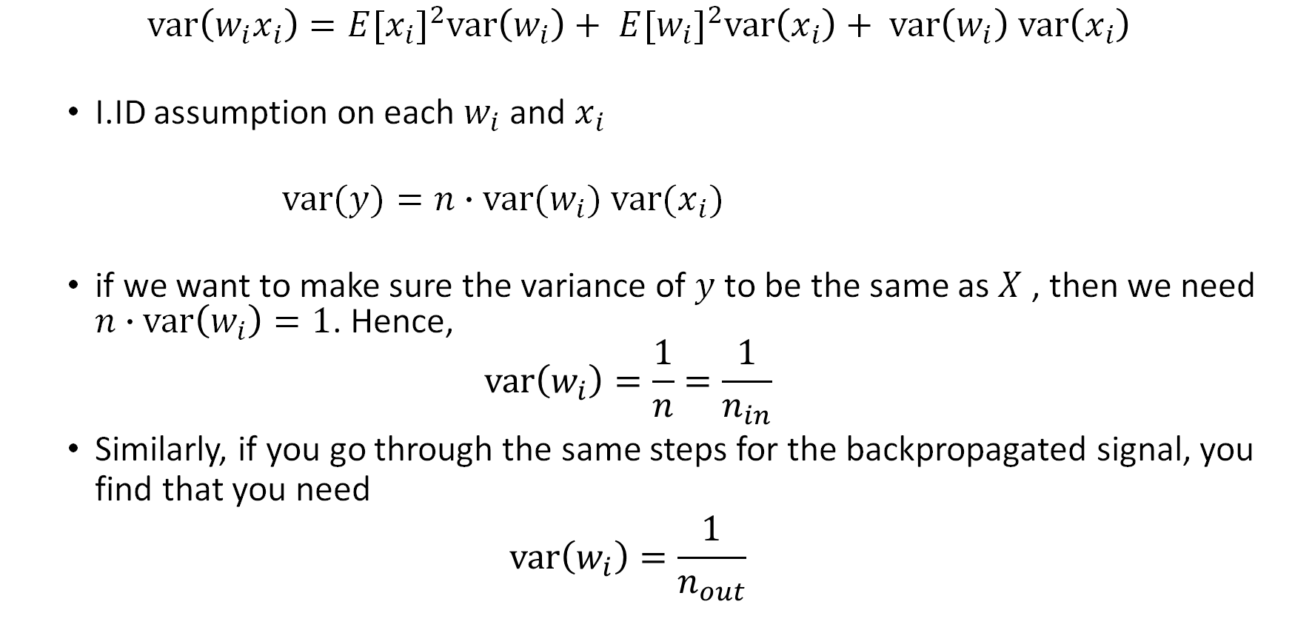
Xavier initialization
$$var\left(w_{i}x_{i}\right)={E[x_{i}]}^{2}var\left(w_{i}\right)+ {E[w_{i}]}^{2}var\left(x_{i}\right)+ var\left(w_{i}\right) var\left(x_{i}\right)$$
I.ID assumption on each $w_{i}$ and $x_{i}$
$var(y)=n∙var(w_{i})$ $var(x_{i})$
if we want to make sure the variance of $y$ to be the same as $X$ , then we need $n∙var\left(w_{i}\right)=1$. Hence,
$$var\left(w_{i}\right)=\frac{1}{n}=\frac{1}{n_{in}}$$
Similarly, if you go through the same steps for the backpropagated signal, you find that you need
$$var\left(w_{i}\right)=\frac{1}{n_{out}}$$

Slide 53

Xavier initialization
These two constraints can only be satisfied simultaneously if $n_{in}=$ $n_{out}$
As a compromise,
$$var\left(w_{i}\right)=\frac{2}{{n_{in}+n}_{out}}$$
Moreover, the author also introduced a normalized initialization version follows uniform distribution
$$W\sim U[−\frac{\sqrt{6}}{\sqrt{{n_{in}+n}_{out}}},\frac{\sqrt{6}}{\sqrt{{n_{in}+n}_{out}}}]$$
What’s more, Xavier with uniform distribution + sigmoid activation
$$W\sim U[−\frac{4∙\sqrt{6}}{\sqrt{{n_{in}+n}_{out}}},\frac{4∙\sqrt{6}}{\sqrt{{n_{in}+n}_{out}}}]$$

Slide 54
Xavier initialization
Xavier is aimed to deal with gradient vanishing or exploding problems
Xavier initialization would not be use with ReLU activation, which would not lead to vanishing or exploding gradients

Slide 55



ReLU initialization
Proposed to handle the issue that some very deep CNNs have difficulties to converge
Weights in those CNN are initialized by random weights drawn from Gaussian distributions with fixed standard deviations
$n_{l}$: size of layer $l$
$$W\sim N(0,\sqrt{\frac{2}{n_{l}}})$$
$$W\sim U[−\sqrt{\frac{6}{n_{l}}},\sqrt{\frac{6}{n_{l}}}]$$

